Slide 1
Basic Search into PID ML
Using Deep NN

Slide 2
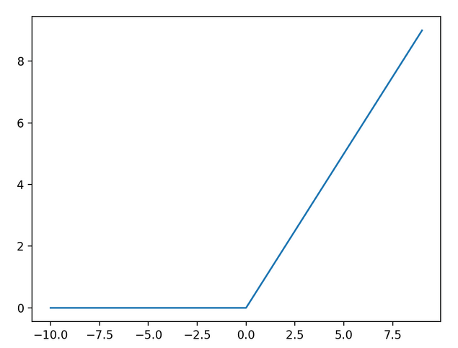
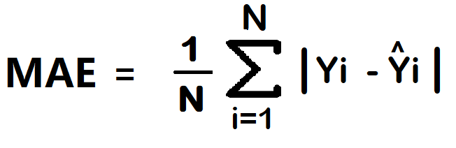
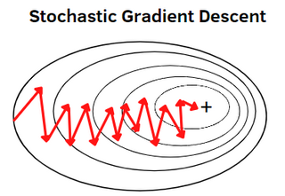
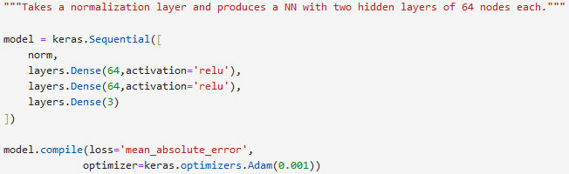
Tools
Example ReLU
Used the Keras library in Tensorflow platform
Created a neural network (NN) with two hidden layers
Activation method: Rectified linear unit (ReLU)
A piecewise linear function
This determines how each node contributes to the model prediction
Loss function: Mean absolute error (MAE)
This is the objective function that is minimized
It represents how closely the model answers fit the training labels
Can think of MAE like a kind of chi^2
Optimizer: Adam
This is the method in which the model uses to minimize the loss function
Improved version of stochastic gradient descent where the learning rate is constant
Learning rate = magnitude at which weights on nodes are changed with each back propogation

Slide 3
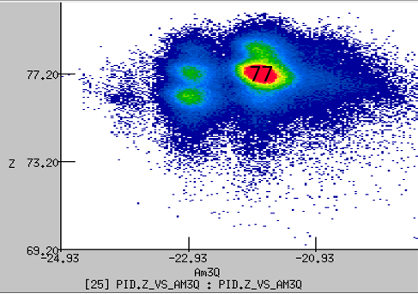
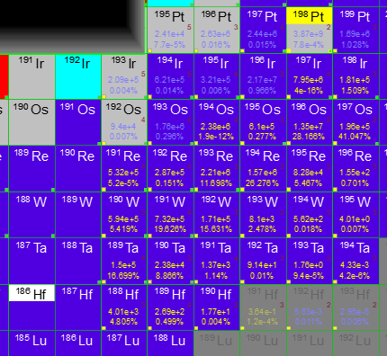
Data Considered
D6b PID
NSCL e15130 ¹⁹⁸Pt data set D6b
Ni targ with Be stripper
A1900 Tuned for 189Hf
PID was unusable in CS analysis
Three variations of separator settings were considered in LISE
^{186,189,192}Hf
Same distribution calculated each time
Brho was slightly changed to simulate such changes during experiment
Slits kept same
¹⁸⁶Hf ¹⁸⁹Hf ¹⁹²Hf
Avg. Brho
DATA USED FOR LEARNING WAS GENERATED MC BY LISE

Slide 4
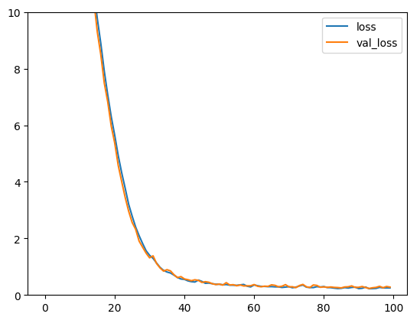



3 Models Considered
Three approaches to input data were considered:
Feed Common Data (7 inputs total)
X position
Brho
dP/P
TKE
Energy loss
Length
ToF
Feed Common + Pseudo Data (11 inputs total)
Velocity
Beta
Gamma
AoQ
Feed Meas. + Pseudo + Analytic Answers (14 inputs total)
A
Z
q
Main Model Parameters:
Feedback strength -> 0.001
Inputs -> (7, 11, 14)
Iterations -> (100, 250, 1000)

Slide 5
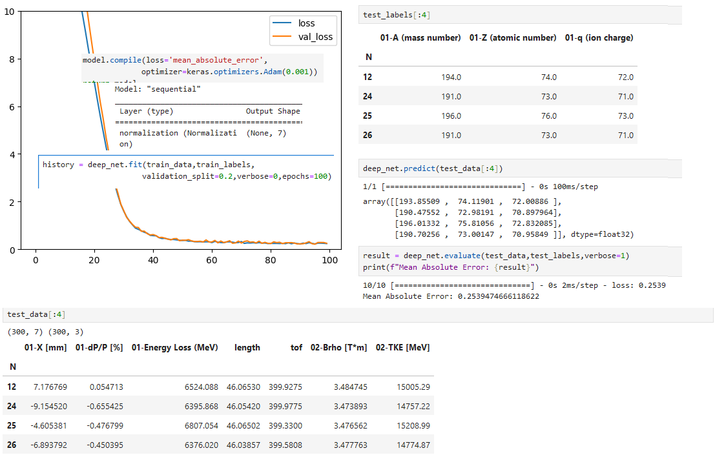
Model 1

Slide 6
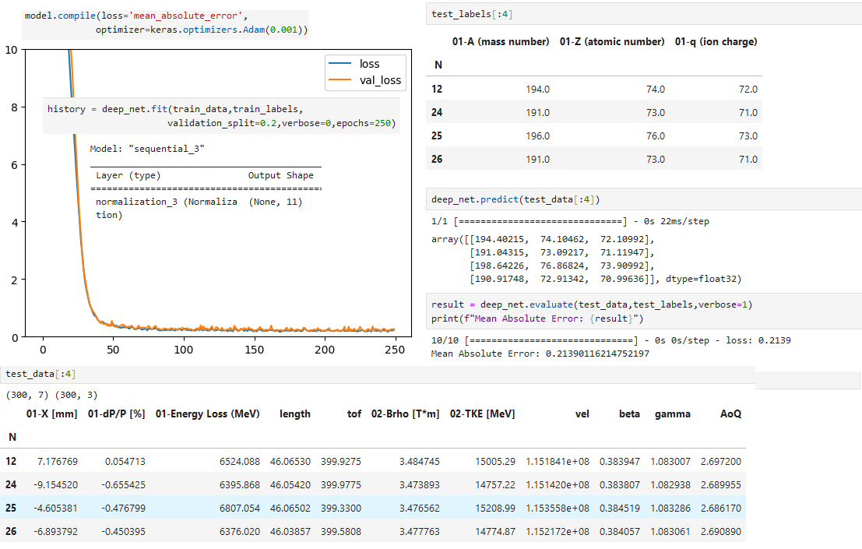
Model 2

Slide 7
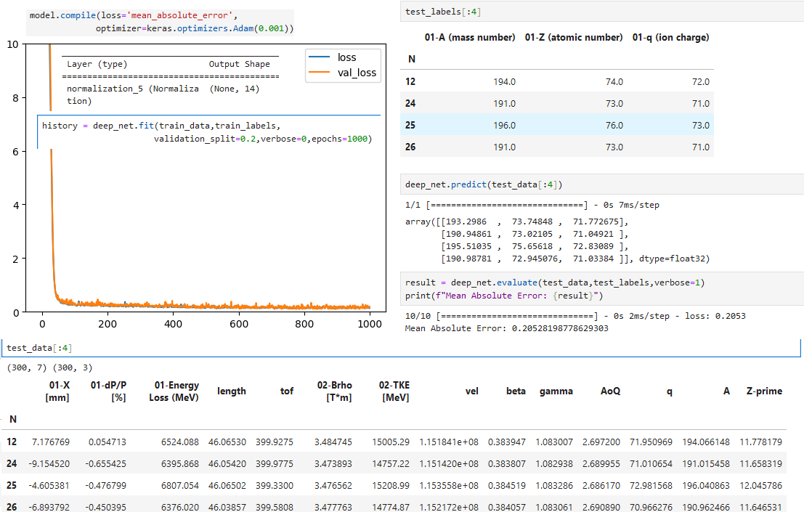
Model 3

Slide 8
Results Summary: MAE
 | ¹⁸⁶Hf | ¹⁸⁹Hf | ¹⁹²Hf
7 Inputs (100 epochs) | 0.245 | 0.254 | 0.259
11 Inputs (250 epochs) | 0.203 | 0.214 | 0.189
14 Inputs (1000 epochs) | 0.195 | 0.205 | 0.180
When attempted with equal iterations, the results had no trend.
Accuracy increased with more parameters but required more iterations.
This means there is no substantial conclusion at this point.
It is important to understand why accuracy doesn’t improve with increasing accurate inputs
Especially when you are essentially feeding it the answers (analytic calculation of AZQ)

